Slide 1
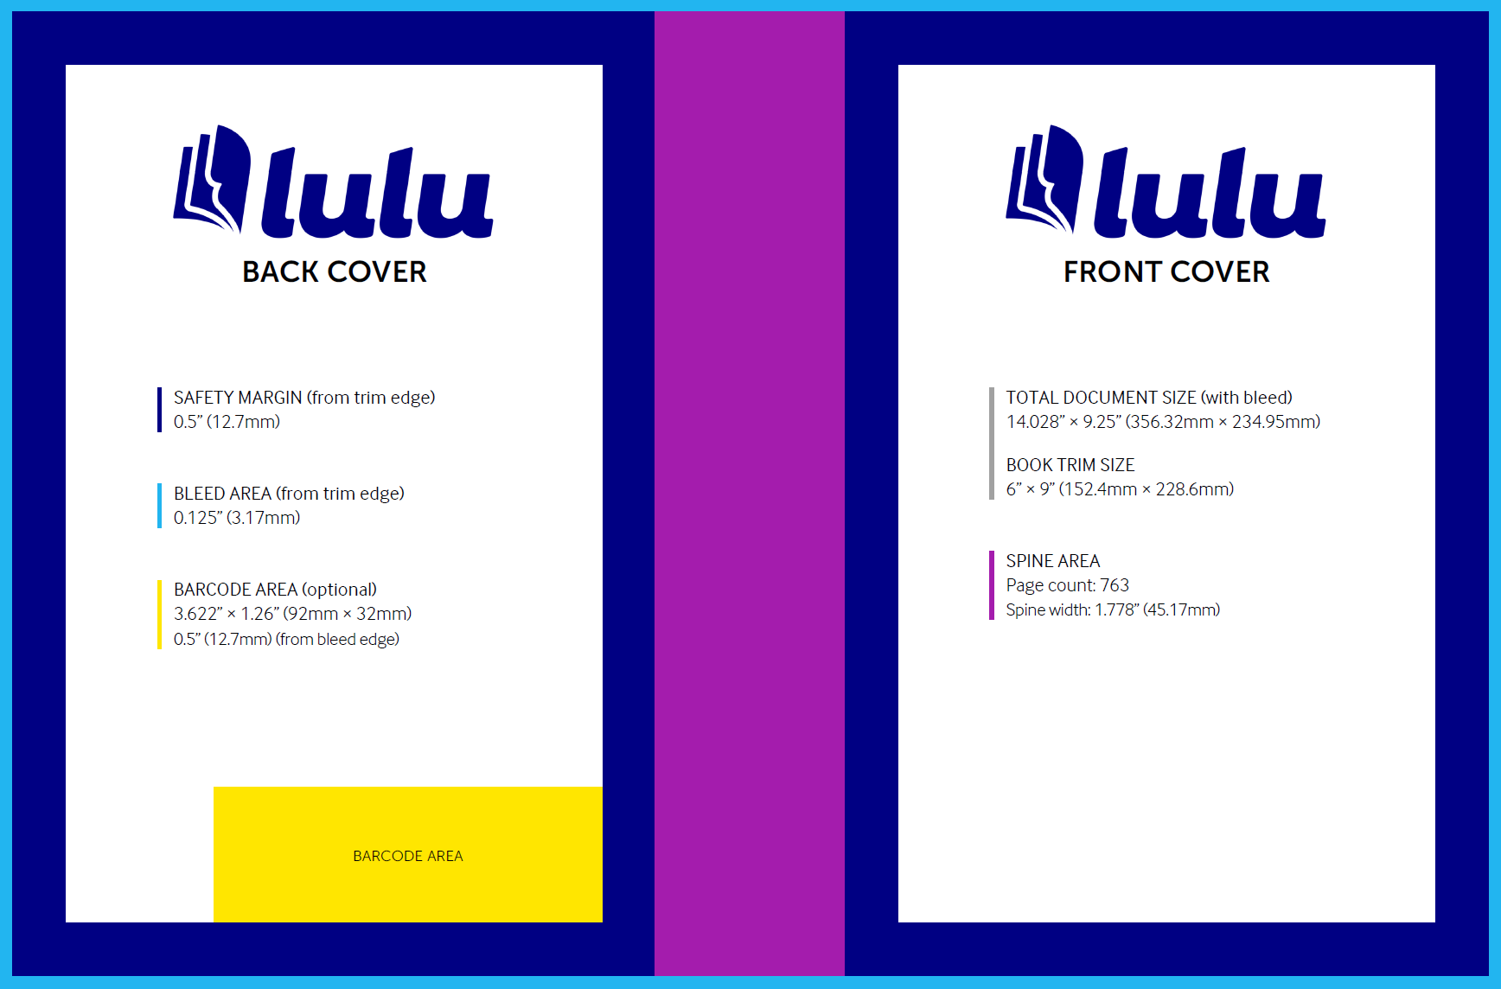
Spine Width
1.778”
Cover Safe Area
5” x 8”
Cover Safe Area
5” x 8”
Barcode Area
3.622” x 1.26”
Barcode Area
2.0” x 1.8”

Slide 2

s
rs
r²s
r³s
r⁴s
r⁵s
e
r⁵
Demystifying
The Language
of Modern Mathematics
r
r⁴
r²
r³
The field of abstract algebra is deeply fundamental to modern mathematics. Working mathematicians, computer scientists, physicists, and chemists frequently encounter topics in abstract algebra, and a basic understanding of abstract algebra would immensely help. To that end, A Complete Introduction to Abstract Algebra provides all the necessary foundation to understand this fundamental study, assuming only a high-school understanding of mathematics. Everything, from the results discussed in the chapters to the questions and exercises, will have detailed solutions and explanations, providing you with the reassurance that you're on the right track and deepening your appreciation of the beauty of abstract algebra.
This book covers the absolute fundamentals of abstract algebra, starting with the prerequisite knowledge, moving on to groups, looking at rings and fields, and ending with an introduction to Galois theory. It adopts a structured approach to learning abstract algebra. Examples, exercises, and problems are frequently interspersed in the text to facilitate understanding, provide insight, and develop the ability to do proofs.
A Complete
Introduction to
ABSTRACT
A Complete Introduction to
ALGEBRA
ABSTRACT ALGEBRA
Kan Onn Kit
1st Edition
Kan Onn Kit
Barcode Area
2.0” x 1.8”
Notes:
Palette
White: ffffff
Lightest Purple: 9F979F
Blue: 231E5C
Darker Blue: 130F2D

Slide 3
s
rs
r²s
r³s
r⁴s
r⁵s
e
r⁵
Demystifying
The Language
of Modern Mathematics
r
r⁴
r²
r³
The field of abstract algebra is deeply fundamental to modern mathematics. Working mathematicians, computer scientists, physicists, and chemists frequently encounter topics in abstract algebra, and a basic understanding of abstract algebra would immensely help. To that end, A Complete Introduction to Abstract Algebra provides all the necessary foundation to understand this fundamental study, assuming only a high-school understanding of mathematics. Everything, from the results discussed in the chapters to the questions and exercises, will have detailed solutions and explanations, providing you with the reassurance that you're on the right track and deepening your appreciation of the beauty of abstract algebra.
This book covers the absolute fundamentals of abstract algebra, starting with the prerequisite knowledge, moving on to groups, looking at rings and fields, and ending with an introduction to Galois theory. It adopts a structured approach to learning abstract algebra. Examples, exercises, and problems are frequently interspersed in the text to facilitate understanding, provide insight, and develop the ability to do proofs.
A Complete
Introduction to
ABSTRACT
A Complete Introduction to
ALGEBRA
ABSTRACT ALGEBRA
Kan Onn Kit
1st Edition
Kan Onn Kit
Notes:
Palette
White: ffffff
Lightest Purple: 9F979F
Blue: 231E5C
Darker Blue: 130F2D

Slide 4

Spine Width
1.778”
s
rs
r²s
r³s
r⁴s
r⁵s
Cover Safe Area
5” x 8”
e
r⁵
Demystifying
The Language
of Modern Mathematics
r
r⁴
r²
r³
The field of abstract algebra is deeply fundamental to modern mathematics. Working mathematicians, computer scientists, physicists, and chemists frequently encounter topics in abstract algebra, and a basic understanding of abstract algebra would immensely help. To that end, A Complete Introduction to Abstract Algebra provides all the necessary foundation to understand this fundamental study, assuming only a high-school understanding of mathematics. Everything, from the results discussed in the chapters to the questions and exercises, will have detailed solutions and explanations, providing you with the reassurance that you're on the right track and deepening your appreciation of the beauty of abstract algebra.
This book covers the absolute fundamentals of abstract algebra, starting with the prerequisite knowledge, moving on to groups, looking at rings and fields, and ending with an introduction to Galois theory. It adopts a structured approach to learning abstract algebra. Examples, exercises, and problems are frequently interspersed in the text to facilitate understanding, provide insight, and develop the ability to do proofs.
A Complete
Introduction to
ABSTRACT
A Complete Introduction to
Kan Onn Kit
ABSTRACT ALGEBRA
ALGEBRA
1st Edition
Kan Onn Kit
Barcode Area
3.622” x 1.26”
Notes:
Palette
White: ffffff
Lightest Purple: 9F979F
Blue: 231E5C
Darker Blue: 130F2D

Slide 5
s
rs
r²s
r³s
r⁴s
r⁵s
e
r⁵
Demystifying
The Language
of Modern Mathematics
r
r⁴
r²
r³
The field of abstract algebra is deeply fundamental to modern mathematics. Working mathematicians, computer scientists, physicists, and chemists frequently encounter topics in abstract algebra, and a basic understanding of abstract algebra would immensely help. To that end, A Complete Introduction to Abstract Algebra provides all the necessary foundation to understand this fundamental study, assuming only a high-school understanding of mathematics. Everything, from the results discussed in the chapters to the questions and exercises, will have detailed solutions and explanations, providing you with the reassurance that you're on the right track and deepening your appreciation of the beauty of abstract algebra.
This book covers the absolute fundamentals of abstract algebra, starting with the prerequisite knowledge, moving on to groups, looking at rings and fields, and ending with an introduction to Galois theory. It adopts a structured approach to learning abstract algebra. Examples, exercises, and problems are frequently interspersed in the text to facilitate understanding, provide insight, and develop the ability to do proofs.
A Complete
Introduction to
ABSTRACT
A Complete Introduction to
Kan Onn Kit
ABSTRACT ALGEBRA
ALGEBRA
1st Edition
Kan Onn Kit
Notes:
Palette
White: ffffff
Lightest Purple: 9F979F
Blue: 231E5C
Darker Blue: 130F2D

